Slide 1
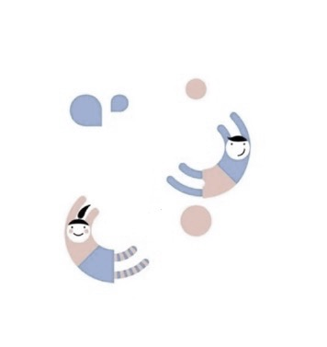
ChoreHarmony
A to-do list fighting inequality
Emma, Jia Guo, Richard, Sophie
Notes:
test

Slide 2
Executive summary
Requirements modelling
Design modelling
Implementation
Testing

Slide 3
Executive summary

Slide 4
Problem: Inequality in chores is rampant
1
2
Unpaid labor
Unrecognized work
Housework isn't paid
Housework isn’t seen
4
3
Inequality rages
Unfair work splits
The problem is systemic
Partners "share" duties

Slide 5
What if an app could shine a light on this problem?
At its core, it’s a to-do list
Scope
But it’s got built-in functionality
to value housework
Scope
Households have two or more members
Each user needs a separate login
Assumption
Households need to divvy up tasks equally
Assumption
Multiple classes: separate logic and
views to enable collaboration
Process

Slide 6

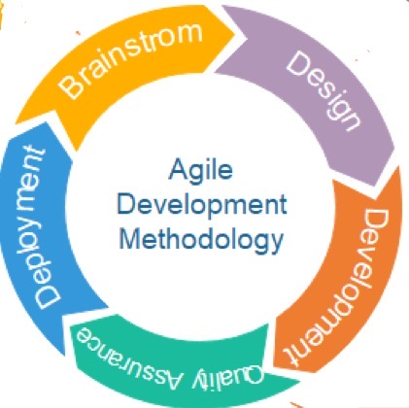
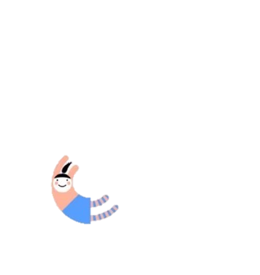
Type of Development Process
Agile!
Why?
Because it’s a new, user-centric product,
so iterating on user-feedback is essential!

Slide 7
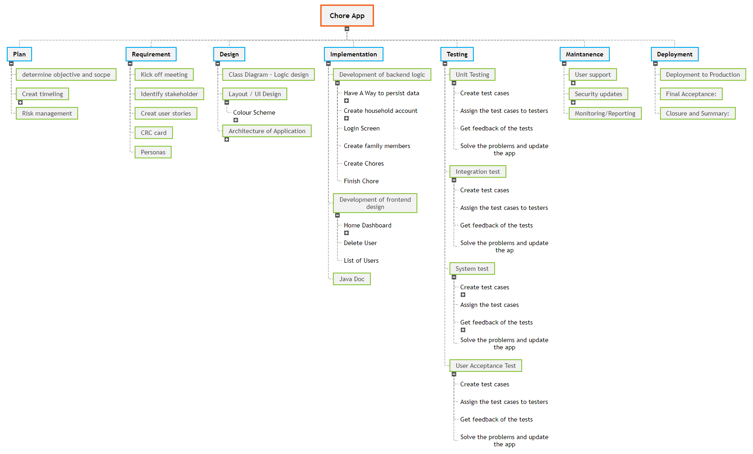
Work Breakdown Summary

Slide 8
Timeline
 | Monday (10.30) | Tuesday (10.31) | Wednesday (11.01) | Thursday (11.02) | Monday (11.06) | Tuesday (11.07) | Wednesday (11.08) | Thursday (11.09)
Planning
Design
Implementation
Testing
Presentation preparation
Presentation Rehearsal
Presentation
In the real-world, it would take 3-6 months of work to build and release the app!

Slide 9
Risk Identification
Risk
Probability
Impact Rating
Score
100%
80
80
Technical challenge
50%
90
45
App store rejection
Time control risk
50%
50
25
80%
20
16
Competitive pressure
User adoption
30%
50
15
30%
50
15
Budget control risk
Notes:
1. Technical challenge - We need to build a database for the chore app as there will be data of different members to be store and shared among them.
2. App store rejection - The app may be at risk of rejection when submitted to the app store, such as the Apple App Store or Google Play Store due to various reasons, including non-compliance with app store guidelines, technical issues, or content violations, or because the app is too similar to other apps already in the app store.
3. User adoption - Low User Acceptance - users may not like the chore app’s interface design or functionalities, leading to low user acceptance.
4. Budget control risk – The chore app may challenges due to insufficient financial resources, budget cuts, or unexpected financial constraints.
6. Time Control Risk - The chore app may not be completed according to the planned schedule or deadline due to various reasons, such as insufficient resources, technical issues, change requests, developing team members unwell, problems occurred due to the first time cooperating on Git, external disruptions, etc.
6. Competitive Pressure - Other competitors may introduce similar chore management apps, leading to intense competition.

Slide 10
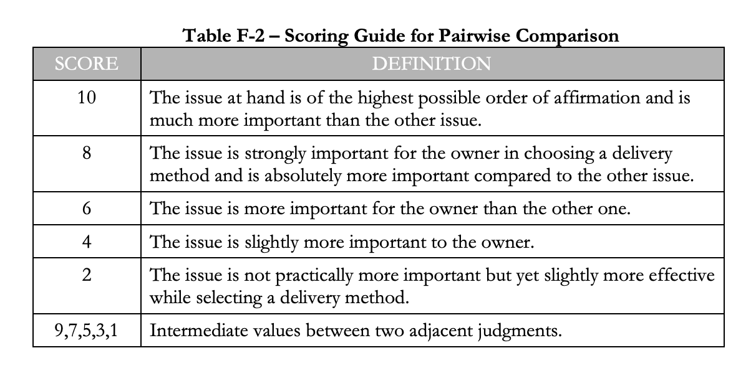
Risk Quantification- Pairwise Comparison
Notes:
Scoring guide for pairwise comparison

Slide 11
Risk Quantification- Pairwise Comparison
Risk | Technical Challenge | User Adoption | Budget Control Risk | Time Control Risk | Competitive Pressure | App Store Rejection | Total | Weight
Technical challenge | 1 | 7 | 7 | 5 | 8 | 3 | 31 | 31/62.69 =49.4%
User adoption | 1/7 | 1 | 1 | 1/2 | 1 | 1/4 | 3.89 | 3.89/62.69 =6.2%
Budget control risk | 1/7 | 1 | 1 | 1/2 | 1 | 1/4 | 3.89 | 3.89/62.69 =6.2%
Time control risk | 1/5 | 2 | 2 | 1 | 2 | 1/3 | 7.53 | 7.53/62.69 =12%
Competitive pressure | 1/8 | 1 | 1 | 1/2 | 1 | 1/4 | 3.88 | 3.89/62.69 =6.2%
App store rejection | 1/2 | 3 | 3 | 2 | 3 | 1 | 12.5 | 12.5/62.69 =19.9%
 |  |  |  |  |  |  | 62.69
Notes:
In this method, we compared each risk with the rest of the group and give a preferential level to the risk in each pairwise comparison.
2. App store rejection - The app may be at risk of rejection when submitted to the app store, such as the Apple App Store or Google Play Store due to various reasons, including non-compliance with app store guidelines, technical issues, or content violations, or because the app is too similar to other apps already in the app store.

Slide 12
Risk Mitigation Plan
Technical challenge
Learn to build databases and build one for our app.
App store rejection
Follow app store guidelines; check similar apps; develop our unique functionalities
Time control risk
Check our progress daily with the timeline.
Competitive pressure
Conduct regular market competition analysis.
User Adoption
Conduct user research before development; continuously monitor user feedback and make changes accordingly.
Budget control risk
Secure new investors; keep track of all expenses.
Notes:
1. Technical challenge - Learn to build databases and build one for our app.
2. App store rejection –
a. Thoroughly review and understand the app store guidelines and policies (e.g., Apple's App Store Review Guidelines or Google Play Developer Program Policies)
Keep up to date with any updates or changes to these guidelines.
Search in the app store constantly to see if there are too many similar apps.
Position our app with strong differentiated functionalities.
3. Time control risk –
Check up our progress daily with the timeline.
Check on team members and their productivity daily.
Make sure we stick to the design requirement, in this project, just to implement three functionalities, to prevent over implementation, which can cause delay.
Make changes accordingly if potential delay is expected.
Ensure we communicate with each other before making any move to the git.
4.competitive pressure - Conduct regular market competition analysis to understand competitors' dynamics and strive to provide a better user experience and value-added functionalities.
5. user adoption - Conduct user research before application development to ensure that it meets user needs and expectations. Continuously monitor user feedback and make improvements to the interface and functionalities.
6. budget control risk - Secure new investors for our app. Keep close track of all the expenses at all stages.

Slide 13
Requirements modelling

Slide 14
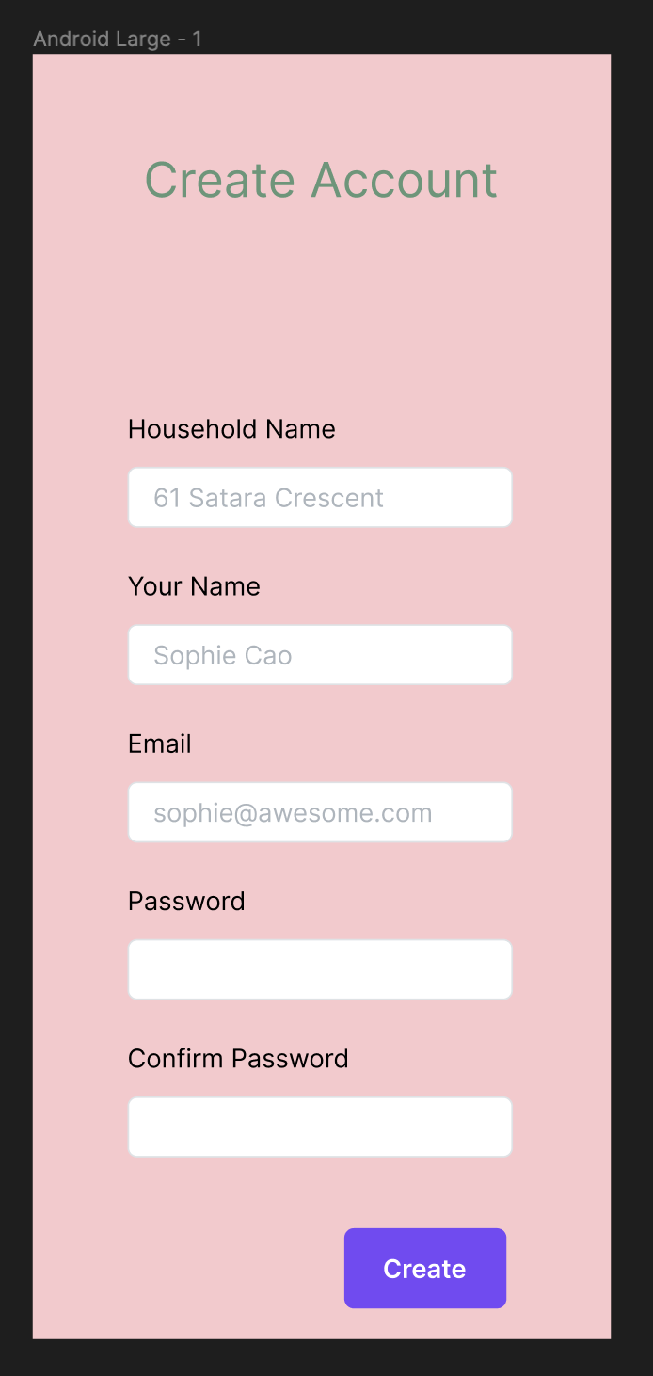
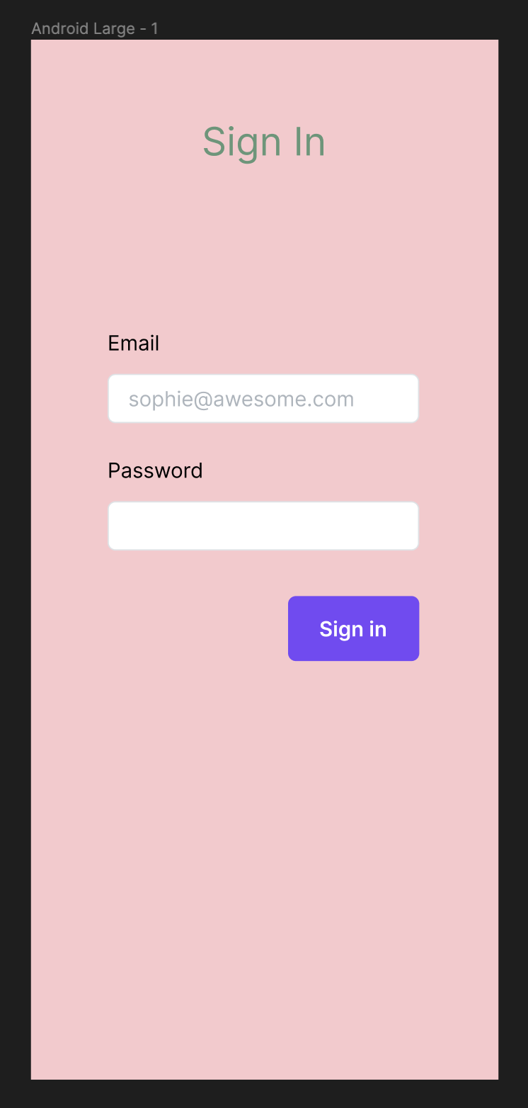
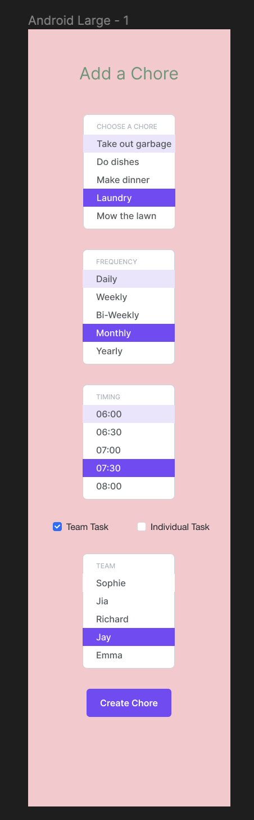
Mockups
Core functionality we created for this exercise

Slide 15
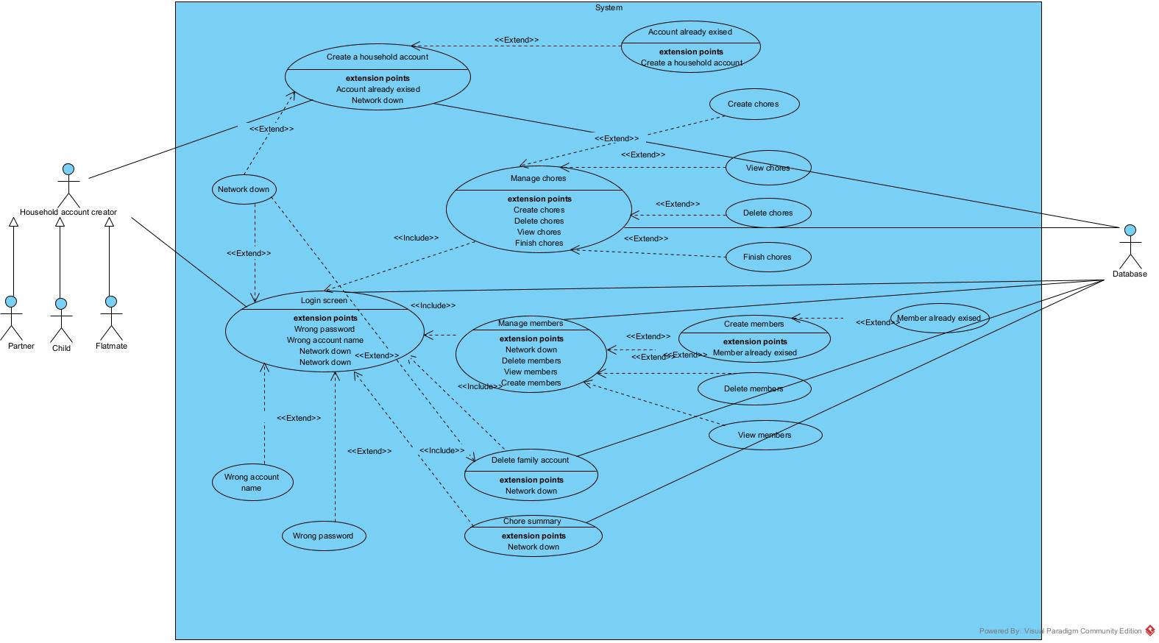
Use Case Diagram

Slide 16
Design modelling

Slide 17
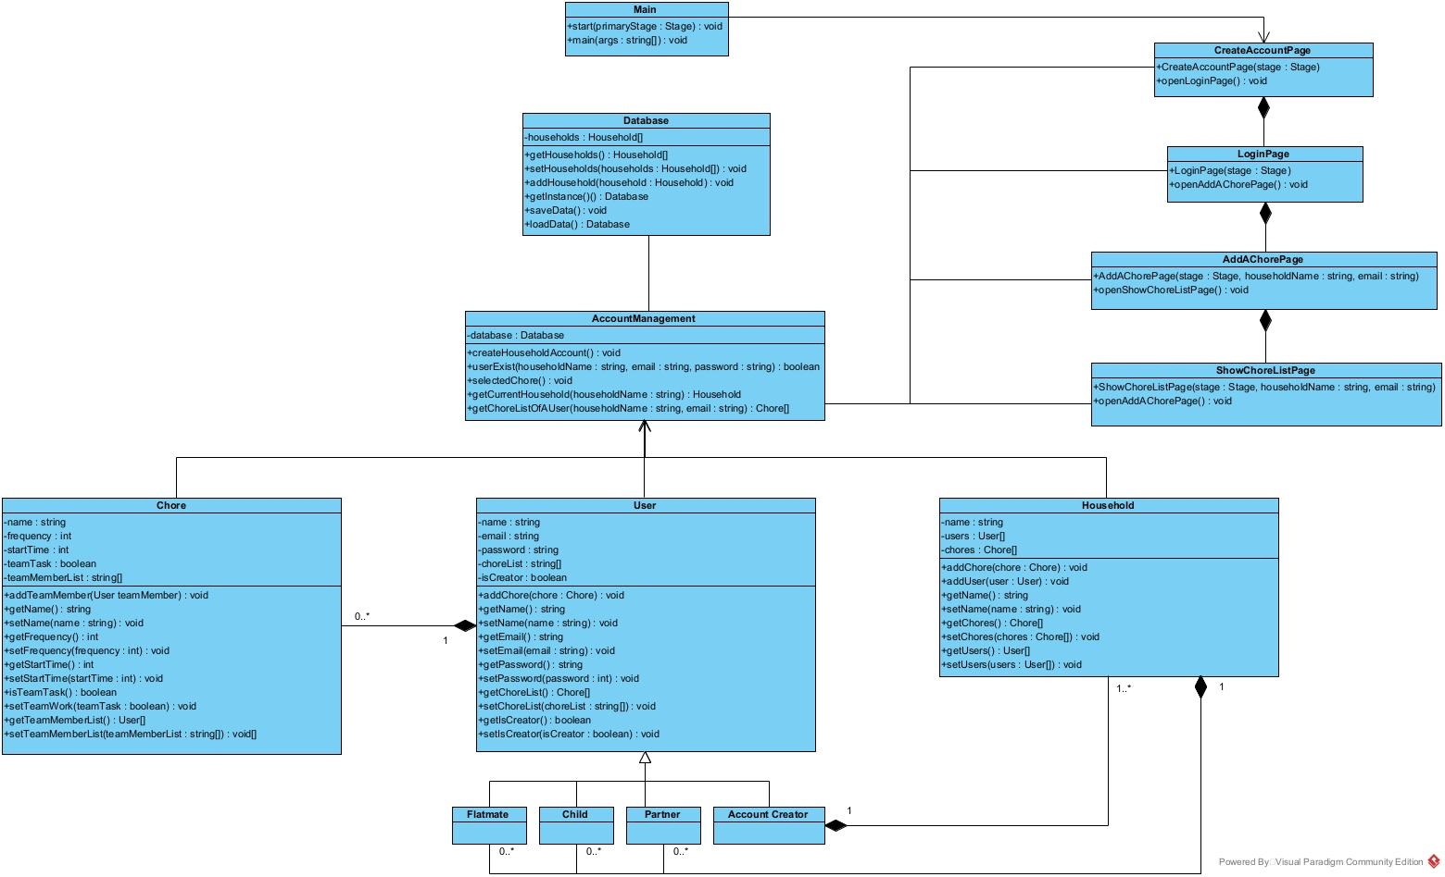
Class Diagram
Notes:
Before we start doing our class diagram, we did the (CRC) Class Responsibility Collaborator to jot down each part of the frontend design and backend logic.

Slide 18
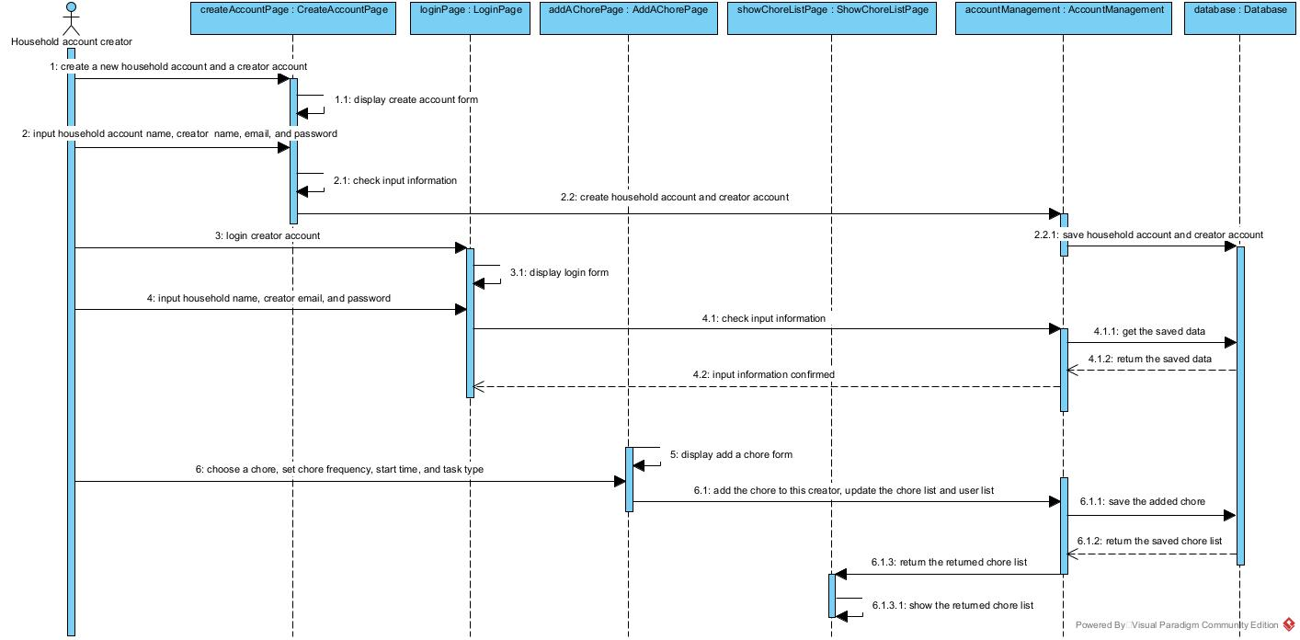
Sequence Diagram

Slide 19
Implementation

Slide 20
Testing

Slide 21
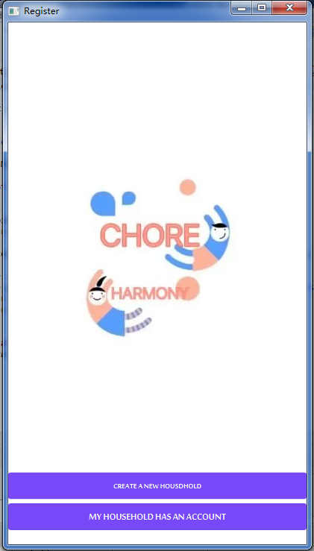
Implementation
Notes:
Let me introduce the Implementation part. Following our design modeling and Requirements modelling, we used JavaFX to design the UI and program for our chore harmony app.

Slide 22
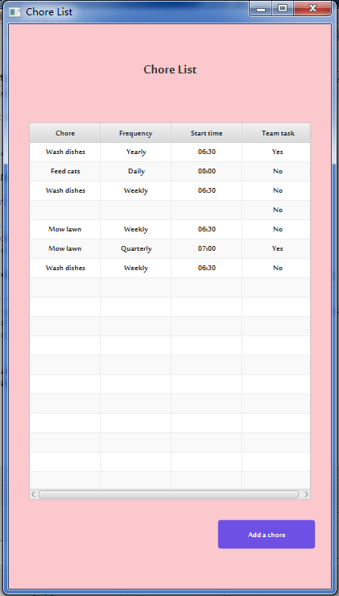
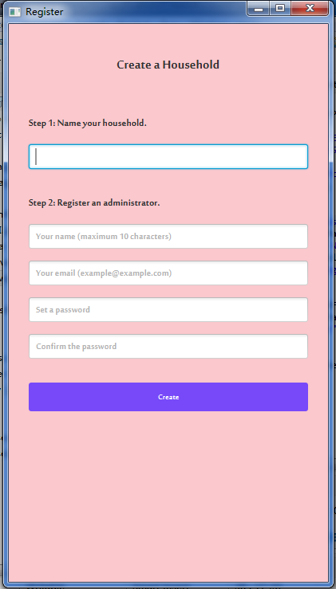
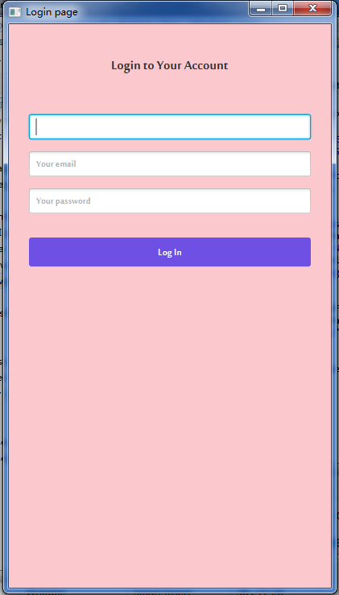
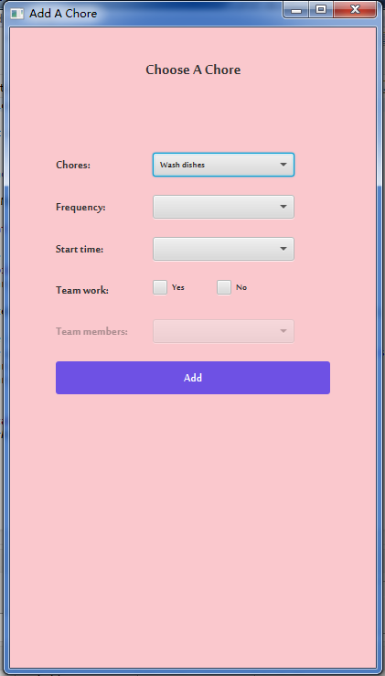


Implementation
Final Project
Hi，I ’m a household creator.
Notes:
In our final app development, we show 5 pages and implemented three main functions: create account function, login function and add a chore function. Let's take a look at the performance of each function .

Slide 23
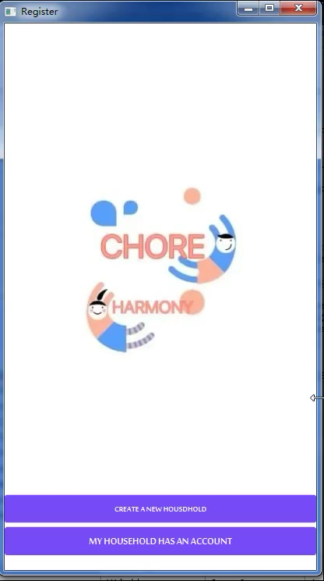
Implementation
Final Project
Create account
Notes:
On the account creation page, we demonstrated a two-step process (household name and creator’s information)with only PromptText in the input fields. A prompt box provides different alert message，If the input words does not match the requirements.

Slide 24
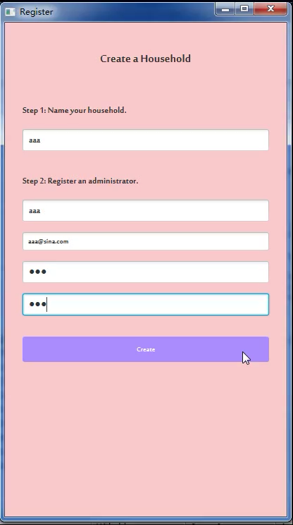
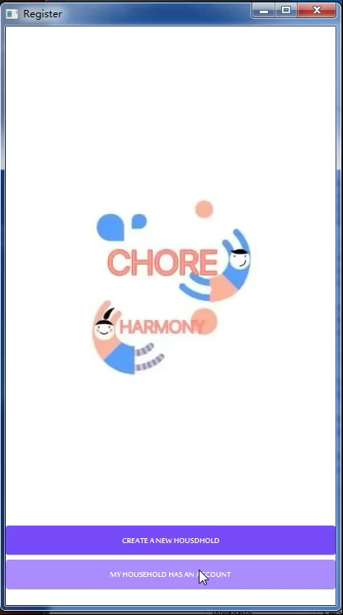


Implementation
Final Project
Login page
Notes:
It will jump into the login page. On this page, incorrect household name, email,or password will show the alert message(as we created in account) ,.If all the formats are matched the data in database, then we can proceed to the ”Choose a Chore" page.

Slide 25
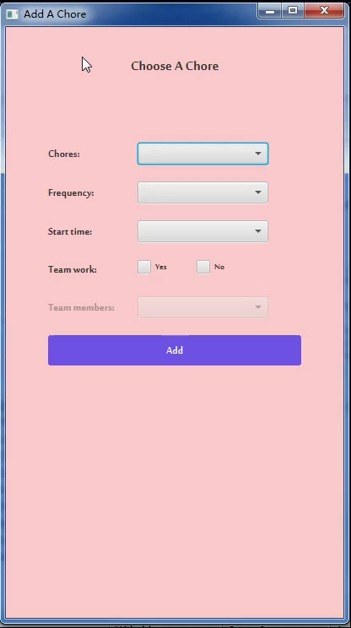
Implementation
Final Project
Choose a chore page
Notes:
On this page, we can only proceed to the next page if all options have been selected. Otherwise it also shows the alert message.

Slide 26
？
Notes:
At this point, do you have any questions?Yes,Our final project are different from the original design

Slide 27
Implementation
Original Design

Slide 28
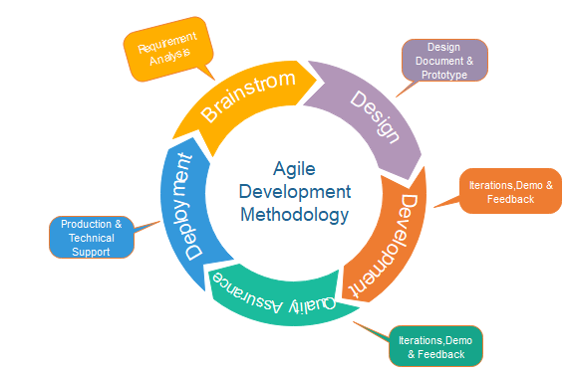
Always Remember! Agile Process!

Slide 29

User testing feedback
Implementation
Your app design seems very crowded.
Users who already have accounts cannot log in directly.
You keep opening new stages. It can move forward by entering a space.

Slide 30
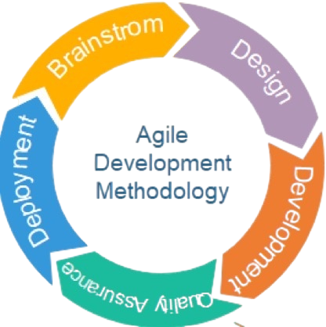
Follow the Agile Process

Slide 31
Some changes happened……

Slide 32
Implementation
Change1: added homepage
Notes:
In our final app development, we show 5 pages and implemented three main functions: create account, login and add a chore list

Slide 33
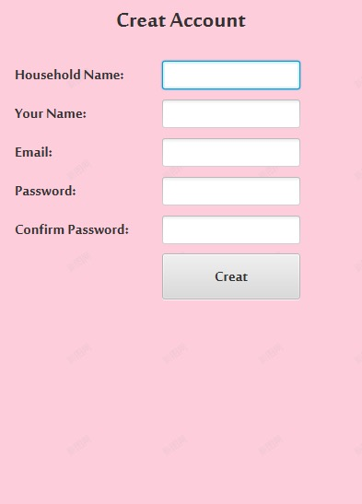
Implementation
Change2: removed lable in create-account page, changed into PromptText
Notes:
Change into PromptText

Slide 34
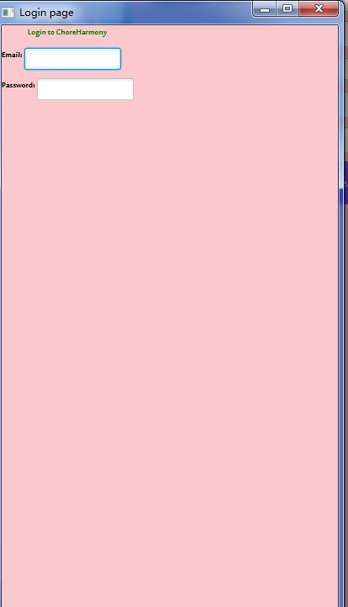
Implementation
Notes:
In our final app development, we show 5 pages and implemented three main functions: create account, login and add a chore list

Slide 35
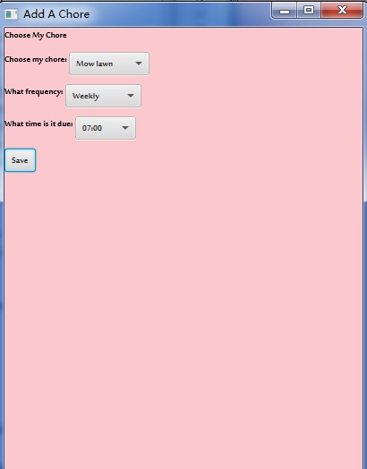
Implementation
Change3: added checkBox
Notes:
In our final app development, we show 5 pages and implemented three main functions: create account, login and add a chore list

Slide 36
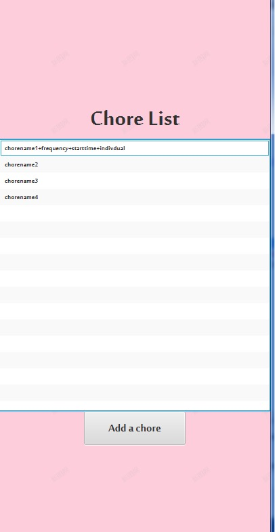
Implementation
Change3:updated the tableview
(loaded from database) to show the list in it’s account
Other changes…

Slide 37
Implementation
Original Project

Slide 38
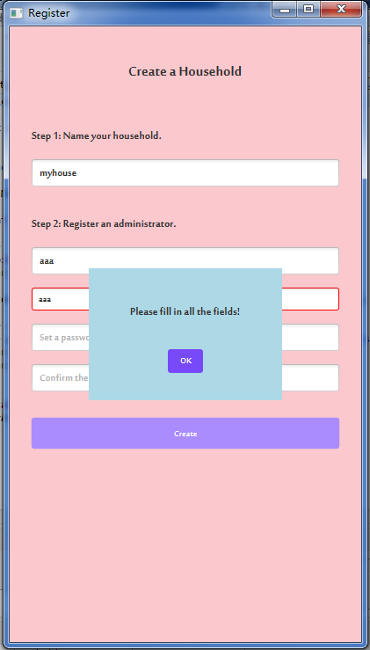
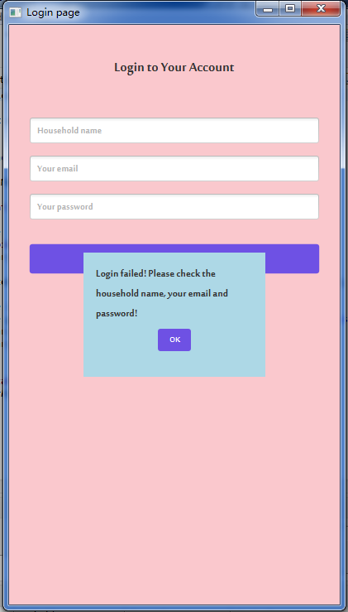
Implementation
Final Project
Notes:
What you see now is the final Implementation。

Slide 39
Testing

Slide 40
Unit Test
User Test
Notes:
Our testing has two parts, one is the unit test using JUnit, which tests the validity of functionalities of the app; the other one is a user test which tests whether the app meets the user’s needs and expectations.
To run the Junit tests, we modified our codes to make them available for testing, which followed the Agile Process.
We tested all three functions but I’ll only talk about some of them as the time limits.

Slide 41
Unit Test
Testing - Create account functionality
Task
Purpose
Valid Input
If the input is valid, the method returns the corresponding successful message.
Empty Field
If any filed is empty, the method returns the corresponding error message.
Unmatched Password
If the password and confirm password do not match, the method returns the corresponding error message.
Email Format
If the email format is wrong, the method returns the corresponding error message.
Notes:
For the unit test, we tested the create account functionality first.
Particularly, we expected to confirm if a new account can be created in these four situations.
The first one is the valid input test, which means the user inputs the valid information.
The next three are the invalid input tests, including the user keeping any of the fields empty, or the password and confirm password don’t match, or the email is in the wrong format.

Slide 42
Unit Test
Testing - Create account functionality - Valid Input
- Test case
Household name | Creator name | Email | Password | Confirm password | Successful message
“aaa” | “aaa” | “aaa@sina.com” | “123” | “123” | “Create successful!”
- Test result
- Test method
Notes:
This is the test case when the user fills in the create account form correctly, the account should be created successfully.
And the test result demonstrated it.
We used this test case as the reference for building the test cases of invalid input testing.

Slide 43
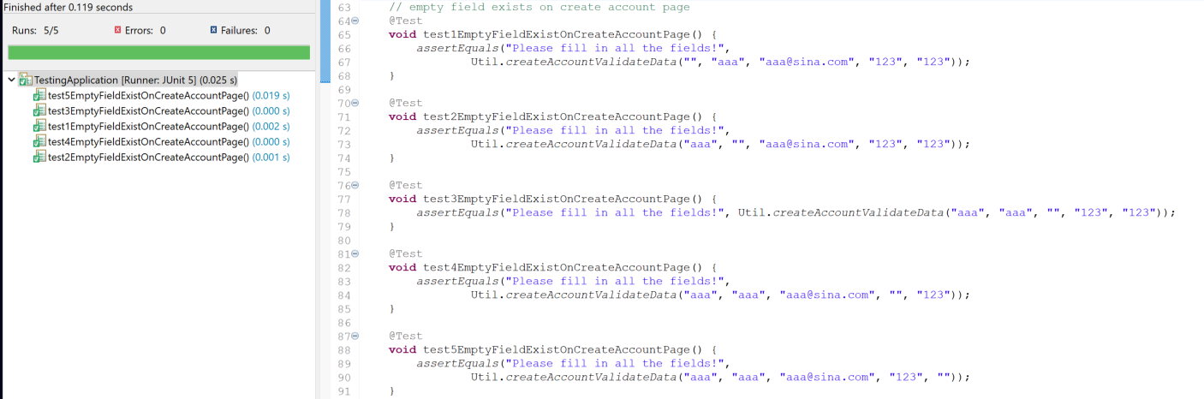
Unit Test
Testing - Create account functionality - Empty Field
- Test case
Household name | Creator name | Email | Password | Confirm password | Error message
“” | “aaa” | “aaa@sina.com” | “123” | “123” | “Please fill in all the fields!”
“aaa” | “” | “aaa@sina.com” | “123” | “123”
“aaa” | “aaa” | “” | “123” | “123”
“aaa” | “aaa” | “aaa@sina.com” | “” | “123”
“aaa” | “aaa” | “aaa@sina.com” | “123” | “”
- Test result
Notes:
Then we tested the situation that the user left at least one field empty.
There are five fields on the create account form, so we have five test cases.
In these test cases, we only changed one field once which is in the red square as a variable and kept the others consistent with the valid input test case.
And our app passed all these tests.

Slide 44
Unit Test
Testing - Create account functionality - Empty Field
- Test method

Slide 45
Unit Test
Testing - Create account functionality - Unmatched Password
- Test case
Household name | Creator name | Email | Password | Confirm password | Error message
“aaa” | “aaa” | “aaa@sina.com” | “123” | “124” | “Password does not match!”
- Test result
- Test method
Notes:
For the testing of the unmatched password situation, we changed the confirm password to a different one.
And the test result is positive.

Slide 46
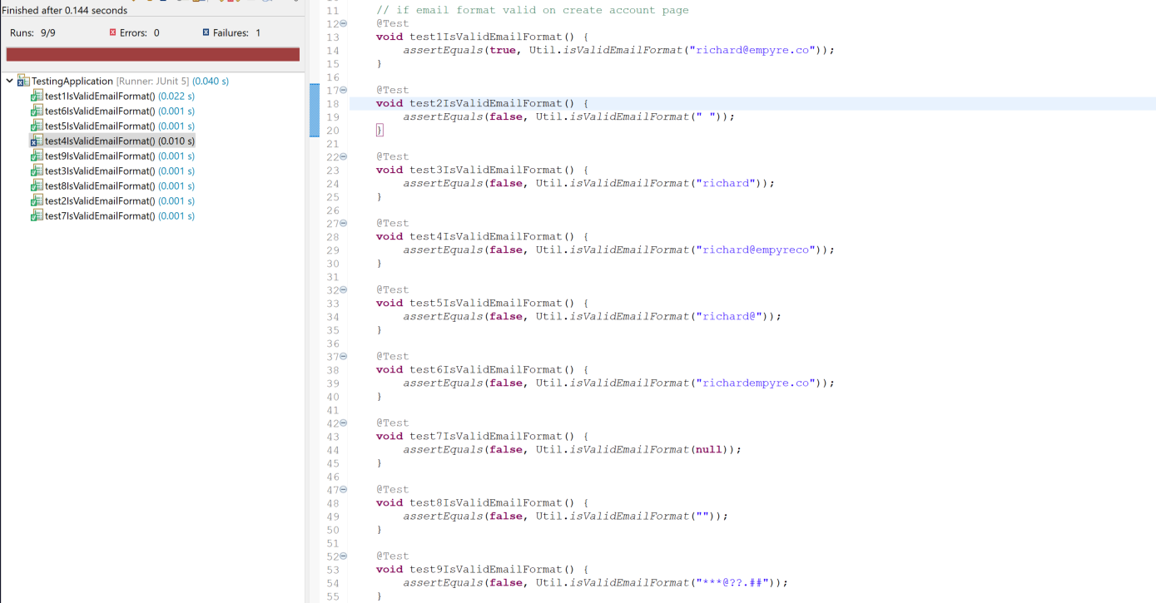
Unit Test
Testing - Create account functionality - Email Format
- Test case
- Test result
Email
(Valid format) “richard@empyre.co”
“ ”
“”
null
“richard@”
“richardempyre.co”
“richard@empyreco”
“richard”
“***@??.##”
String emailPattern = "^[A-Za-z0-9+_.-]+@(.+)$"
Notes:
At last, we tested the method that limited the email format.
The code on the bottom is the valid format for the email.
We used the first test case which is a valid email as the reference for the other test cases.
We tested the cases that the email was a space or empty or null, or without a domain part, or without @ or dot, or without both @ and dot, or only contained symbols for the local part and domain part.
The test result showed a failure for the case that the email only missed a dot, which means the method might not work well for checking this situation.
Besides this, other test cases passed the test.

Slide 47
Unit Test
Testing - Create account functionality - Email Format
- Test method

Slide 48
Unit Test
Testing - Add a chore functionality
Task
Purpose
Valid Input
If the input is valid, the method returns the corresponding successful message.
Empty Field
If any filed is empty, the method returns the corresponding error message.
Notes:
For the add a chore functionalities, we tested if the app responded correctly for both situations inputting the valid information and having any empty filed.

Slide 49
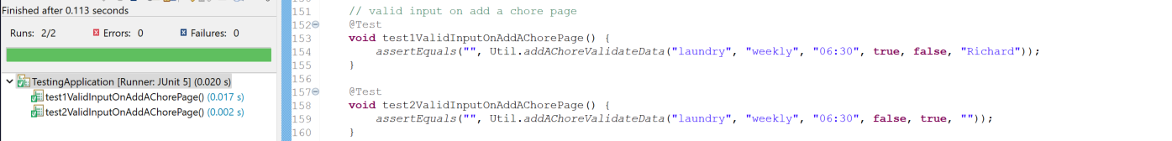
Unit Test
Testing - Add a chore functionality - Valid input
- Test case
Chore name | Frequency | Start time | Teamwork (checkbox) | Not teamwork (checkbox) | Team member
“laundry” | “weekly” | “06:30” | true | false | “Richard”
“laundry” | “weekly” | “06:30” | false | true | “”
- Test result
Notes:
We had two test cases for valid input testing, as the app was designed to have teamwork and individual work.
These two test cases passed the test.

Slide 50
Unit Test
Testing - Add a chore functionality - Valid input
- Test method

Slide 51
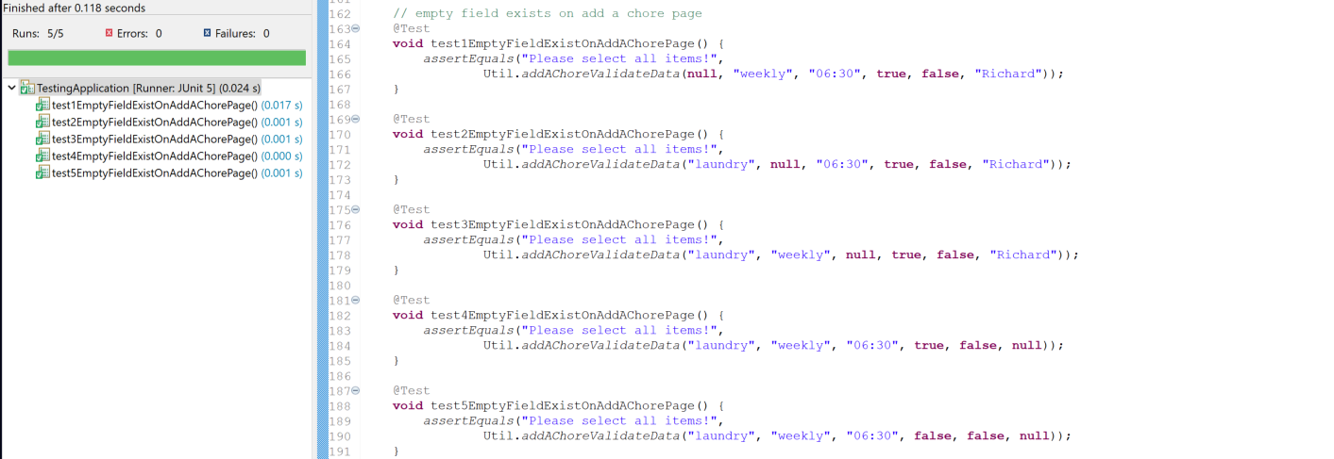
Unit Test
Testing - Add a chore functionality - Empty Field
- Test case
Chore name | Frequency | Start time | Teamwork (checkbox) | Not teamwork (checkbox) | Team member | Error message
null | “weekly” | “06:30” | true | false | “Richard” | “Please select all items!”
“laundry” | null | “06:30” | true | false | “Richard”
“laundry” | “weekly” | null | true | false | “Richard”
“laundry” | “weekly” | “06:30” | true | false | null
“laundry” | “weekly” | “06:30” | false | false | null
- Test result
Notes:
For testing the case of the empty field, we used the valid input test cases as the reference to design the test cases for this test. So in each test case in the table, there is one variable which is in the red square.
The second last test case was to test the situation that the teamwork check box was selected but the user didn’t select the team member, and the last one was to test the condition that both teamwork and not teamwork checkboxes were not selected.
All the test cases passed the test.

Slide 52
Unit Test
Testing - Add a chore functionality - Empty Field
- Test method

Slide 53
User Test
Input only spaces in all the fields, successfully created an account.
Input the email in invalid format, successfully created an account.
When error message shows, user can still fill in the create account form.
Create account functionality
Input the wrong household name, successfully logged in.
Input the wrong email, successfully logged in.
Login functionality
Notes:
We also did the user test, the participant did the black-out testing and found some unexpected problems.
For the user test of the create account functionality, there are three failure cases, first one is the user filled in the form with space only, an account was created successfully, and another one is even if the email format was invalid, a new account could be created as well, and the last one is when the error message was shown on the app, the user could still fill in the form.
To test the login functionality, the paticipant input the wrong email or household name but still logged in the account.
Following the Agile Process, we improved our codes according to these feedbacks.

Slide 54
Thank You

Slide 55
Please Ask Easy Questions

